Slide 1
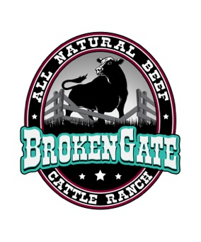
Beef cattle acquired and raised to our specifications for harvesting:
- Angus-Hereford base cattle, bred for marble and flavor
- All cattle acquired as calves direct from known provenances
- No sale barn auction purchases
- Acquired between 7-9 months from date of birth
- Raised to 950 to 1200 pounds on the hoof for harvest
- Track and maintain cattle records from birth to harvest
Grass-fed, pasture raised for 18-21months, then finished for 90 + days on our blend of finish feeding combination of pasture, rich hay and special cattle feed mix to add marbling, flavor and tenderness.
Natural growth & development:
- No growth hormones & growth antibiotics used
- Natural pasture-based grass-fed growth
- More time to naturally mature, develop and grow to reach harvest weight (21-24months)
- Preventive inoculation to maintain health and keep animals free of disease and parasites
Humane low stress harvesting
10-14 day dry-aging process for tenderness and flavor:
Comparison of feeding records against processor’s quality report to improve tenderness and flavor
Custom cut, wrap and freezer pack by certified slaughter-packer
Certified Beef Quality Assurance producer by the Beef Cattle Institute at Kansas State University
A Family
Owned Partnership
234 Ladue Lake Dr.,
Creve Coeur, Mo. 63141
314-704-0693

